Slide 1

MMBS Cycle 2 Presentation
By Austin Mongold, Austin Newkirk, Chase Dumbacher and Sarah Pham

Slide 2










Cycle Intent
Cycle Key Objectives
Website calendar data
Website calendar format
Website football games
iOS documents/email
iOS Bug Fixing

Slide 3
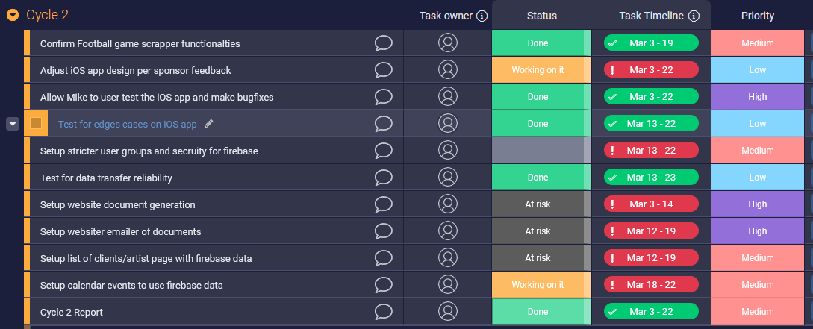
Management Plan

Slide 4
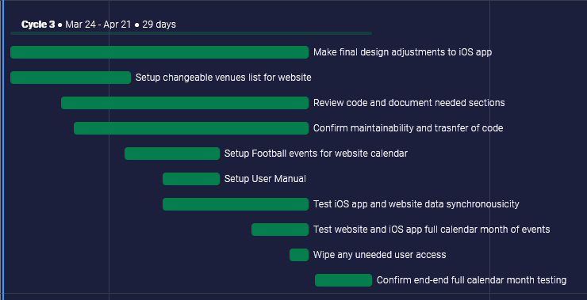
Future Work
Feedback from Mike.
Update and finalize documentation.
Website client and venue list.
Website Documents/Emailing

Slide 5
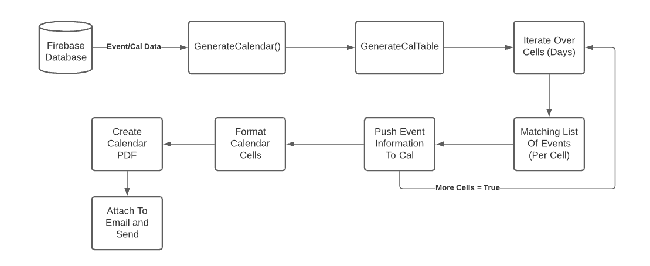
User Story : Calendar Export
Originally failed on button press
PDF Generation issues
Bad Util functions calls
Tested full calendar

Slide 6
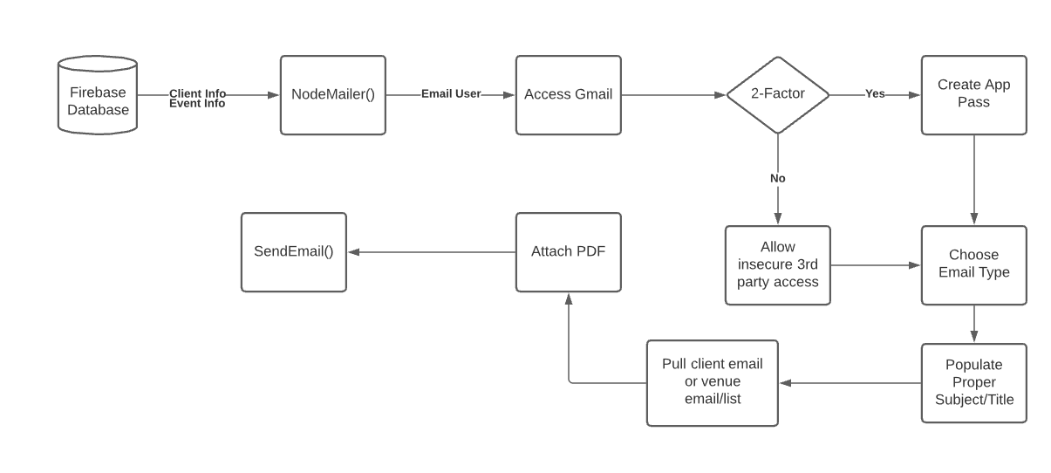
User Story : Emailer
NodeMailer requires user access
Gmail restricts 3rd party access
App pass for Gmail
Bad data reference

Slide 7
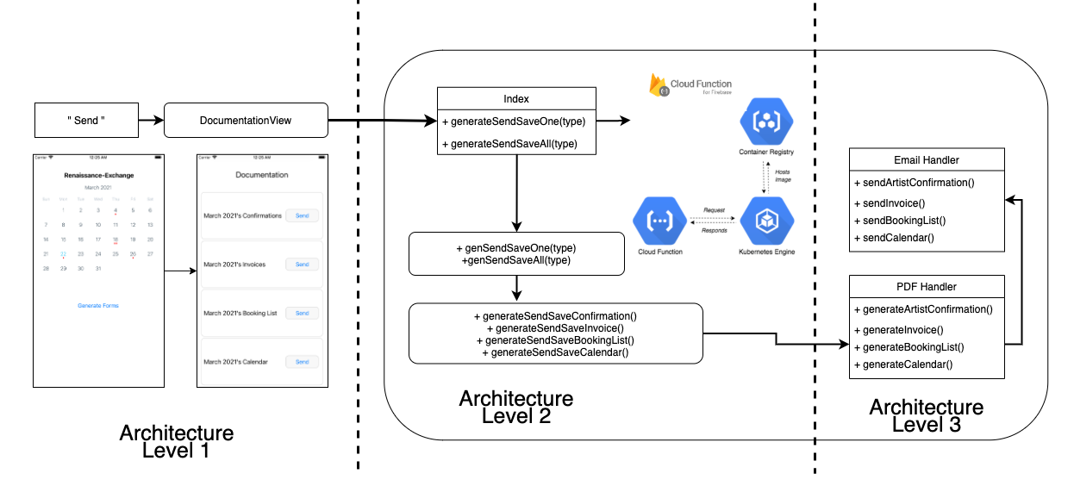
User Story : iOS Bug Fixing
Functional Email System

Slide 8
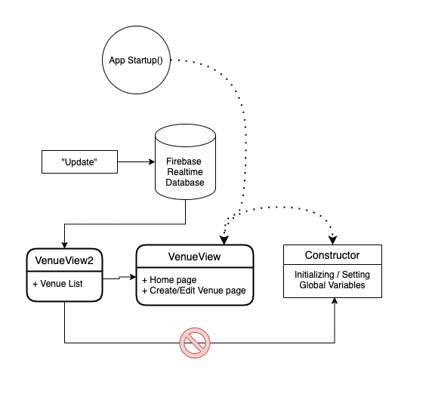
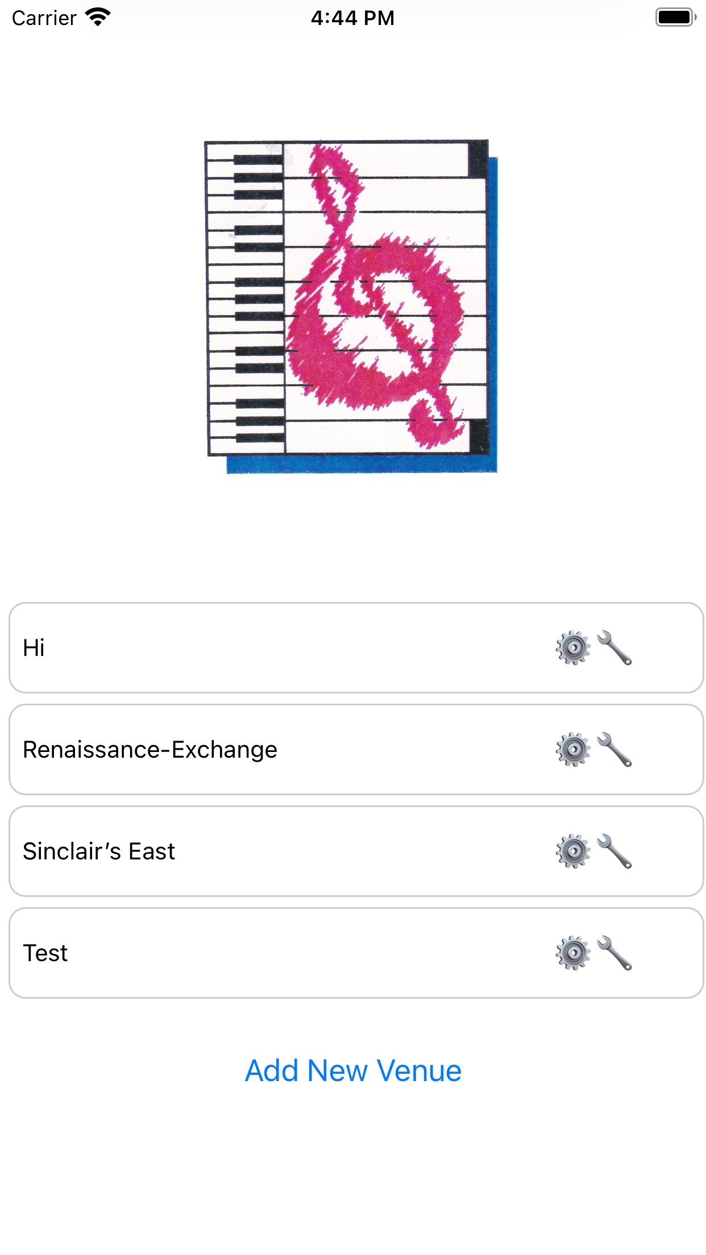
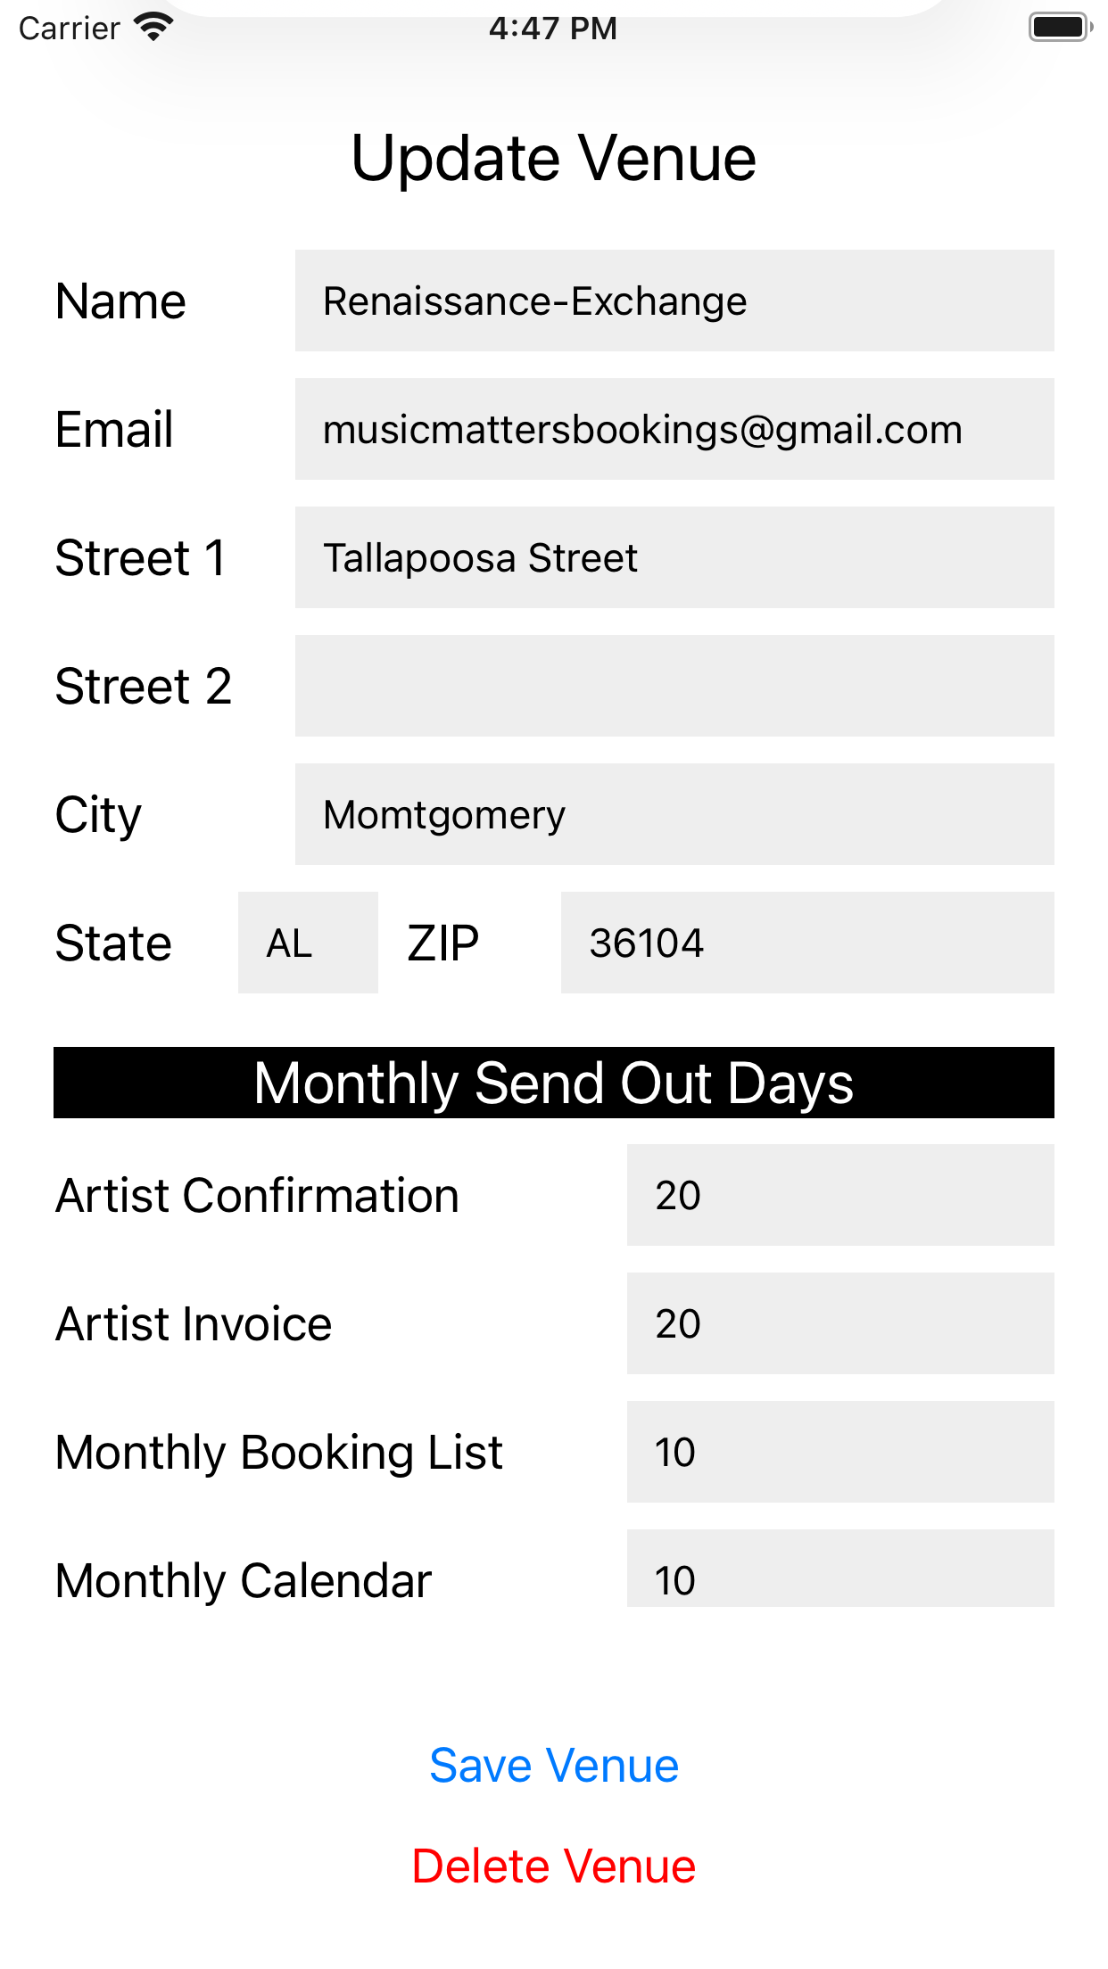
User Story : iOS Bug Fixes
Editing Venues

Slide 9
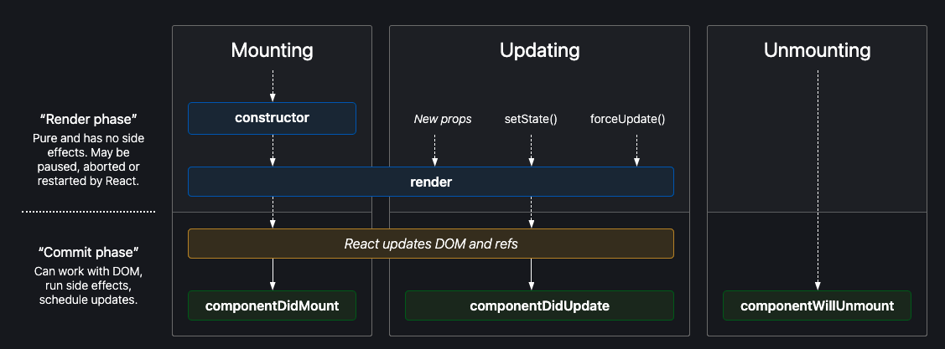
React Native Component Lifecycle

Slide 10
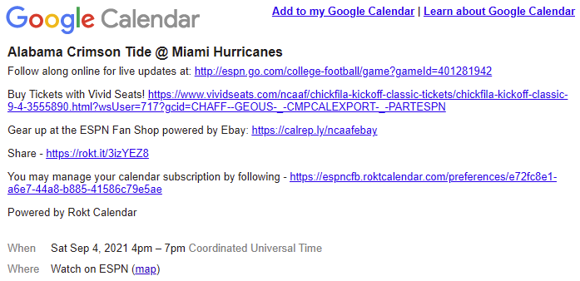
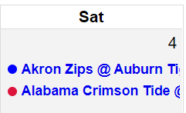
User Story : Web Football Calendar
Linked an ESPN Calendar ID with the website calendar
Displays Auburn and Alabama Football schedules
Each calendar entry is linked to official ESPN information
Color coded each team

Slide 11
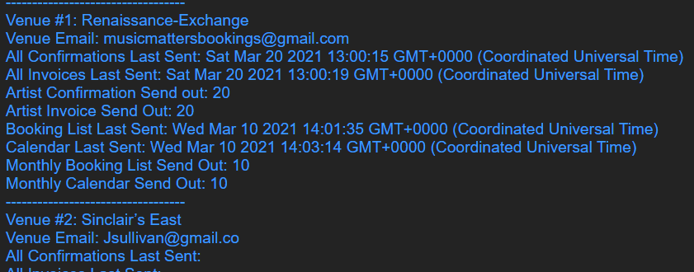
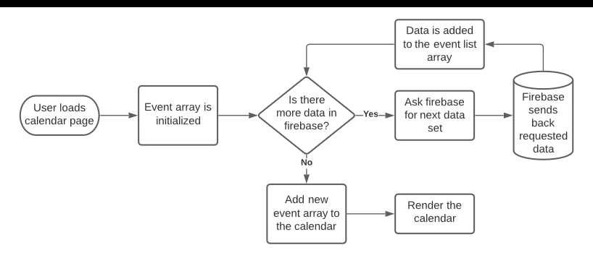
User Story : Web Firebase Calendar
Problems found in how FullCalendar handles async data, causing simple solutions to not work
Data showing on the website itself, not the calendar

Slide 12
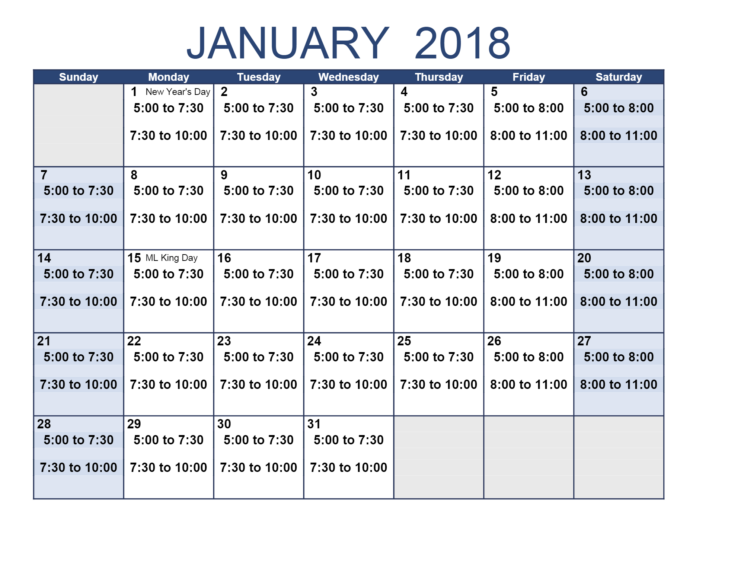



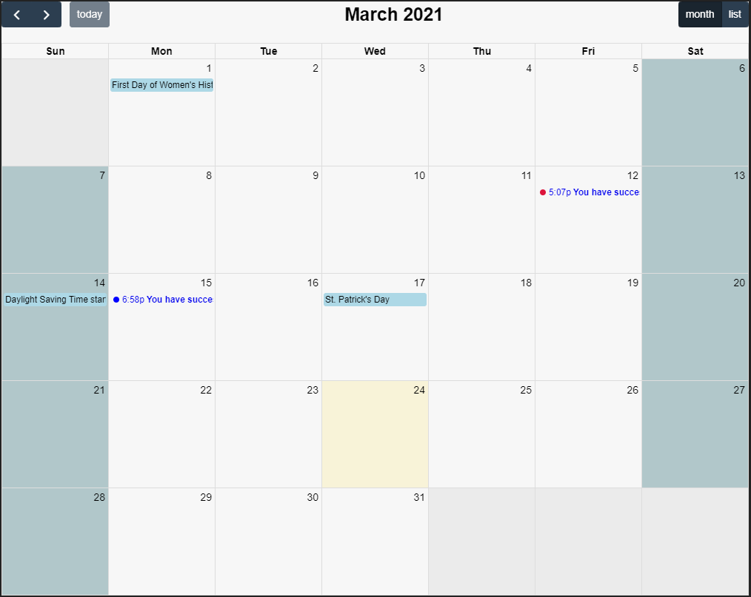
User Story : Web Design Feedback
Updated the design of the web calendar to parallel vertex42 calendar
Added a new design for football games displayed, holidays displayed

Slide 13
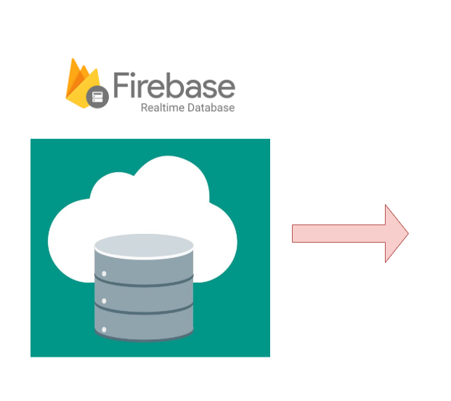
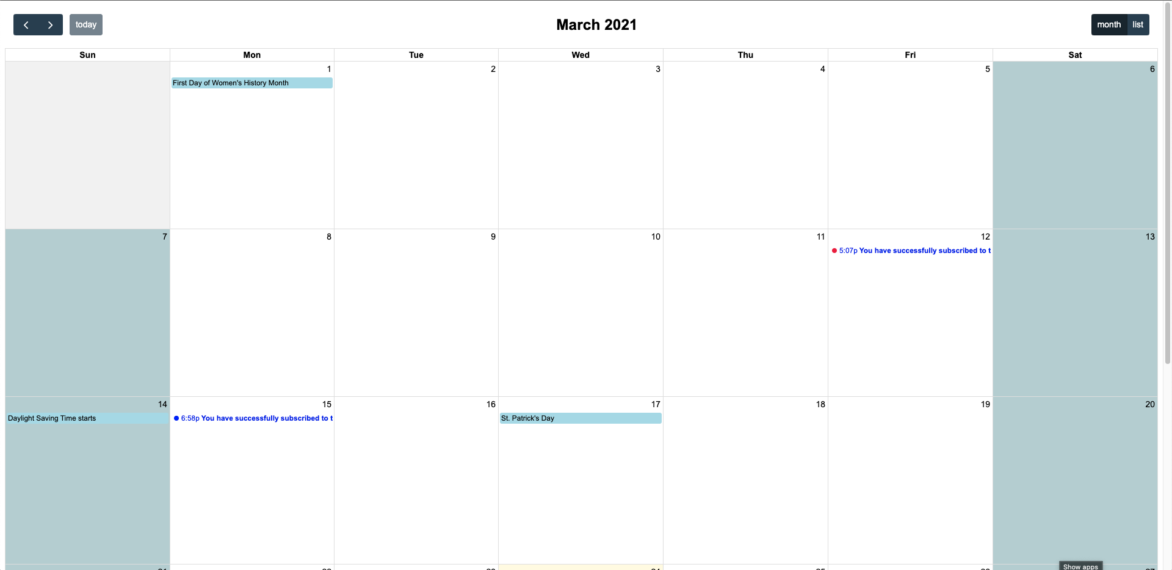
Major Roadblocks
Website: Firebase to Calendar
Notes:
Adding firebase data to FullCalendar. Communication between Firebase and FullCalendar isn’t clean

Slide 14
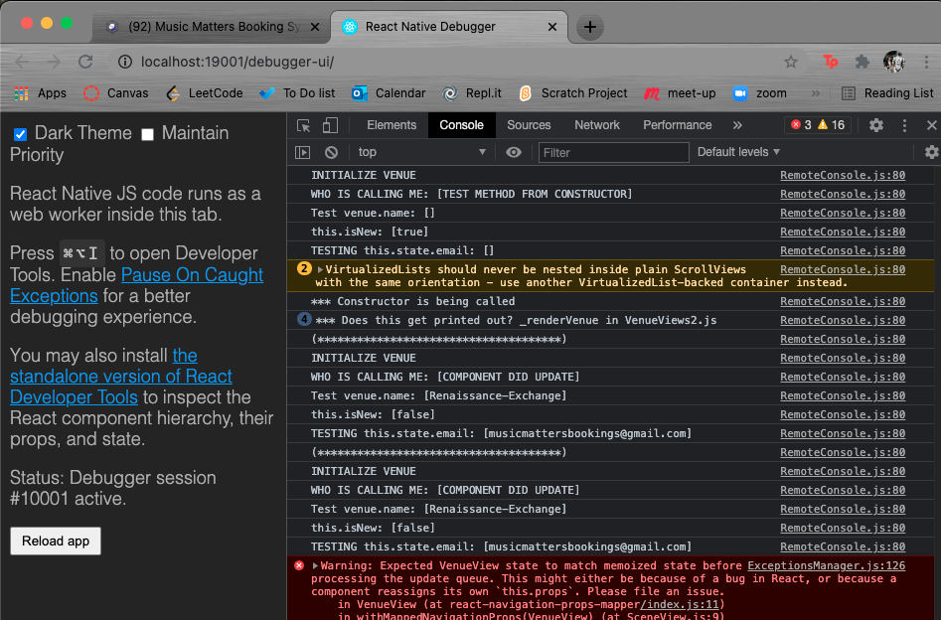
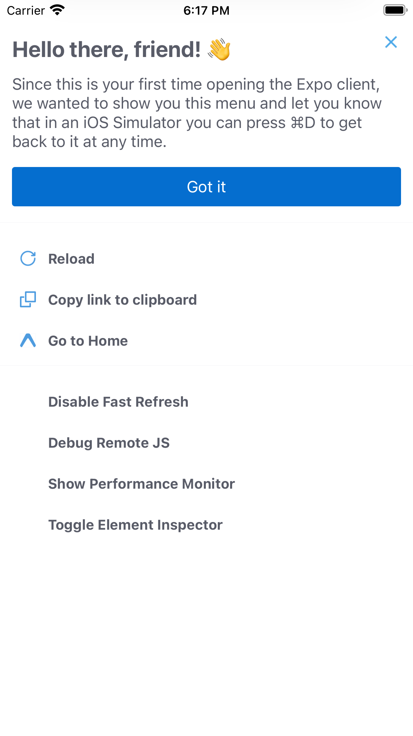
Major Roadblocks
App: Debugging

Slide 15
Website and iOS Demo

Slide 16



Questions

